Slide 1
Obtaining Low-Level Control in a High-Level Language : Variant Types in Data-Parallel Array Languages
Presented by Luuk de Graaf
Luuk de Graaf
Notes:
Hi, I am Luuk de Graaf and am here to present my thesis ‘Obtaining low-level control in a high-level language’… ‘Variant types in data-parallel array languages’.

Slide 2
Introduction : collective operations
Array languages
Collective operators
Map
Fold
Optimizations
Data-parallel
Notes:
Before starting, I am going to introduce the subject…
Array languages can operate on a higher-abstraction level compared to general-purpose language…
They achieve this higher abstraction level through collective operations, which operate on many elements in an array… Collective operations simplify a lot for the programmer…
A collective map function only requires a single function, which is distributed over all elements within the array.
A collective fold function only requires an ...
A lot of optimizations on collective operations can be done implicitly… such as parallel execution…
A motivating example for collective operations is….

Slide 3
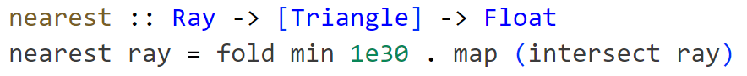
Casus : raytracer
Notes:
Raytracers…
An intersection algorithm for a raytracer can be defined extremely concisely with collective operations…
We have a ray… with a point, and a direction… and we want to know which triangle, that intersects with the ray, is the nearest to our starting point…
We find the distance to all triangles by mapping over all the triangles…
We then fold the results, by taking the minimum of each distance…
And then we have our result…
A collective operation can optimize these operations, by doing them in parallel… potentially vectorize them…
But our intention is clear, and the function can be optimized… even on a higher-abstraction level
This becomes harder when introducing another shape…

Slide 4
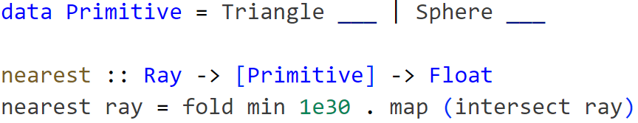
Casus : solution 1 (ADT)
Notes:
Let’s say we want to include spheres… to our raytracer intersection algorithm…
The simplest way to do this is by introducing another datatype, which can either be a triangle or a sphere…
The function remains mostly the same… we just have to define the new intersection for the new datatype…
From a performance standpoint this might not be ideal… considering we are effectively branching on the identity of the primitive each time…
This limits data-parallelism in the general case, as we cannot uniformly operate on elements anymore
From a memory standpoint as well… since if we assume a triangle requires 3 points… a sphere would only need 1 point and a radius… which means we are storing redundant data for each sphere…
Another approach would be to….

Slide 5
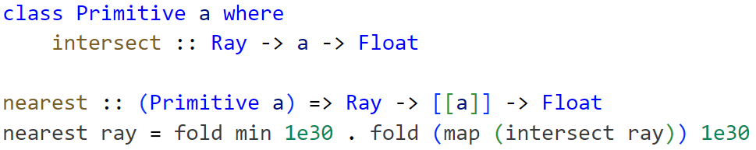
Casus : solution 2 (interface)
Notes:
We can also split up all primitives… in separate collections….
This allows for data-parallelism… as all primitives are stored together…
It avoids redundant data to be stored… as all primitives are stored in the same collection…
This can be achieved nicely through static polymorphism… where an interface ensures all primitives implement the intersection function…
A difference with the previous collective function is that we are folding another time… for all the different primitives…
It means we are folding multiple times….
So while this might be preferable from a performance standpoint… what if we want to know which primitive was the nearest?
Or… when we to extend to other data structures…
In the context of raytracing, this could be an acceleration structure… where we group the primitives based on their spatial properties…
Rather than intersecting all primitives, we can eliminate primitives early… by considering we do not intersect the group of primitives… so we won’t intersect with the primitive itself…
With this… we can also branch on the identity of the group… so we have a group of triangles and a group of spheres… which can be intersected in parallel…
While the specifics are not necessarily important… this would mean another datatype to maintain…
We are trying to achieve low-level control… in a high-level environment…
So, can we abstract over it?

Slide 6
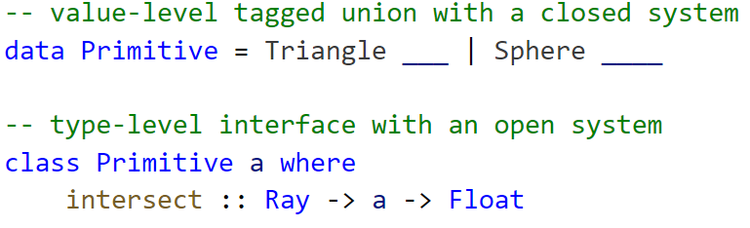
Casus : problem
Abstraction
Intention
Meta-programming
Notes:
We cannot easily create an abstraction over both approaches…
Even though our intention is the same… to iterate on a variant in a collection...
A solution can be to use meta-programming… to generate the datatypes and interfaces generically… but this is unwieldy and does not scale well…
It is also possible to manually distinguish the primitives… which is not type-safe…
Our initial attempt was fine as a surface representation…
But the essence of the problem is that we cannot get low-level control… over the memory representation and the way variants are handled within collective operations…

Slide 7
Question
How to obtain low-level control that is applicable for high performance computing, while preserving the higher-abstraction surface representation?
Notes:
This leads us to the research question…
Which is: “how to obtain low-level control that is applicable for high performance computing, while preserving the higher-abstraction surface representation?”
And in our case: “What is the conceptualization of a higher-abstraction variant type, which can exercise the obtained low-level control within in a data-parallel environment?”

Slide 8
What affects performance?
Notes:
Before considering the abstraction or a possible solution… what actually affects performance… in particular for variant types in collections…

Slide 9
Performance : what affects performance?
Memory
Cache
Alignment
Indirection
Parallelism
Vectorization
External
Device
Memory/Compute bound
Notes:
A lot of talk…

Slide 10
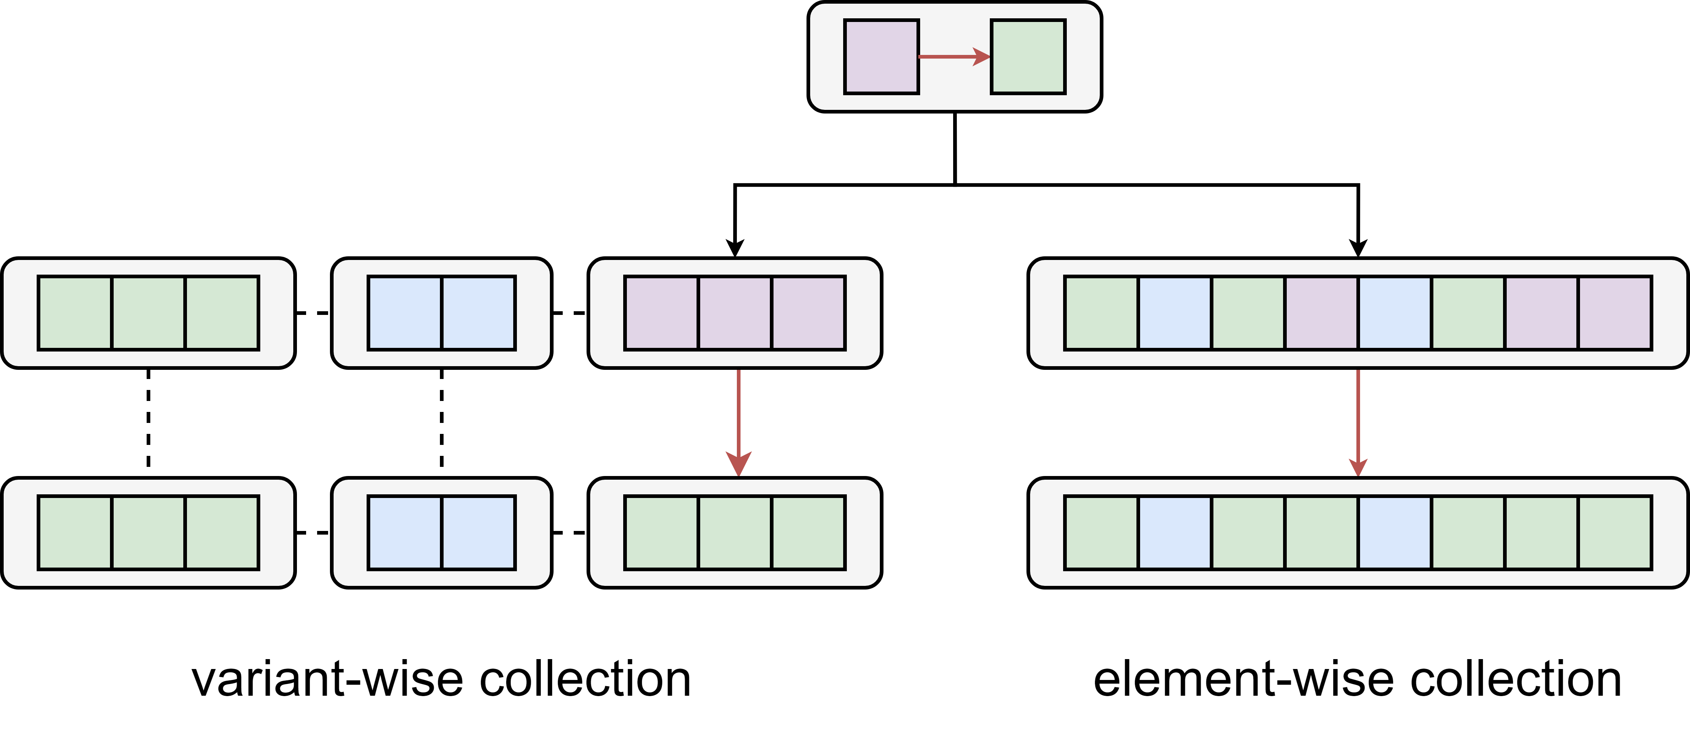
Performance : for variants, what is possible?
Notes:
So… to make it more concrete… for variant types specifically there two main categories…
Which is a variant-wise collection… which stores all variants in a separate group…
In this case each colour denotes a variant… and the grouping can be a separate array… but can also be in the same array… the variant type is implicit based on the location in which it is stored…
An element-wise collection stores all variants in the same group… which requires branching on the identity to know which variant it is…
A hybrid form is also possible… but generally these are the used data structures...
In this example a function transforms the purple variant to a green variant…
The identity of both collections remains the same… it contains green and blue variants… it does not necessarily matter how it is stored…
But what are the considerations for the specific collections….

Slide 11
Performance : element-wise considerations
Fixed size constraint
Tagged Union vs Pointer/Index
Breaks vectorization in the general case
Masking
Representation
Parallel array
Alignment
Deduplication
Notes:
Some considerations for an element-wise collection…
We are constrained to a fixed size… as they are stored within the same array…
We can use a tagged union… or perhaps an indirection to another location…
In the general case vectorization is broken… as we cannot operate uniformly anymore…
We can maybe use masking… to execute unconditionally… by masking side-effects…
Also… the concrete memory representation… do we deduplicate redundant fields… and to what extent...
Do we use parallel arrays… each field has a different array… or do we make it compact in a single array… since it is unlikely we can vectorize anyway…
Deduplication is also harder with parallel arrays, as we are restricted… to a fixed size for each field…

Slide 12
Performance : variant-wise considerations
Vectorization
Rearranging cost
Multiple functions
Variant change not independent
Notes:
For variant-wise collections we can likely vectorize it… but only if the distributed function can be vectorized…
In the case we have an element-wise collection dependant on a computation… what is the cost of rearranging everything… it might be worth it in some cases…
It also uses multiple functions… which can have an overhead… maybe with multiple threads… or we can use task-parallelism…
Another consideration is that the variant change is not independent… a variant change would require a reallocation to a new location… which cannot be done in parallel…

Slide 13
Can we abstract over it?
Notes:
So with all these considerations… is it possible to abstract over element-wise and variant-wise collections?

Slide 14
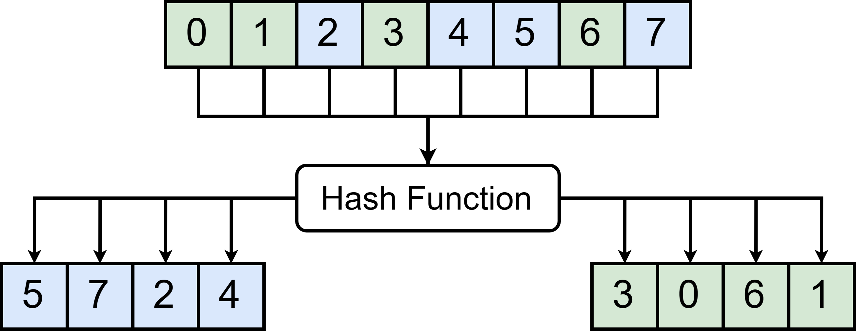
Solution : single abstraction
Notes:
Yes it is…
Indirection is not problematic in itself…
We can use it simulate an heterogeneous collection…
But collective operations can directly operate on a variant-wise collection…
This is shown in the image…
We can use the indirection only when absolute necessary…

Slide 15
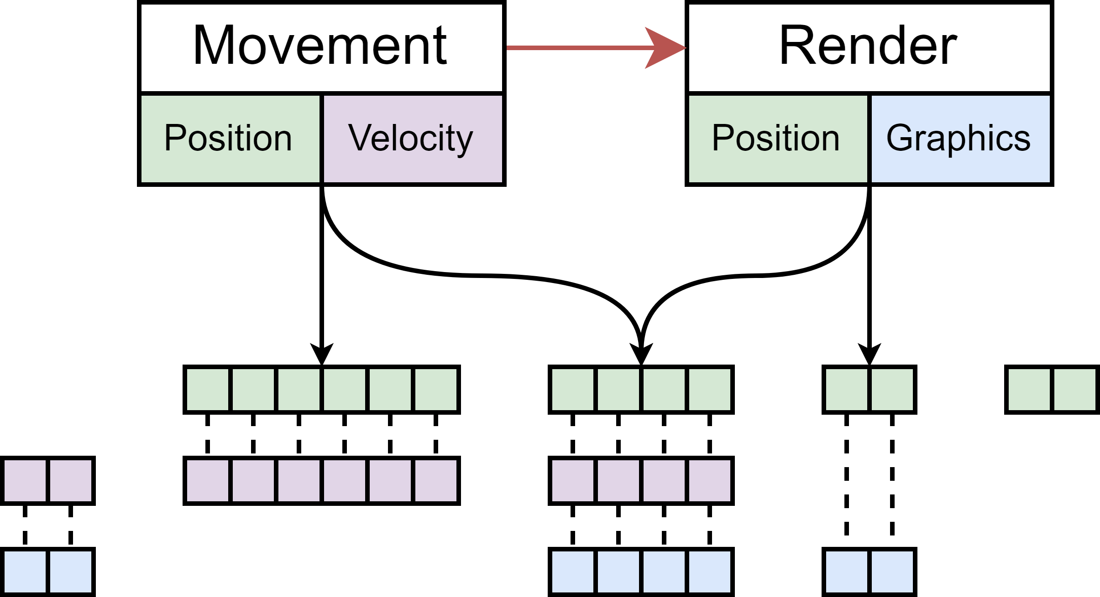
Solution : variant-wise (ECS)
Entity Component System
Composition at runtime
Notes:
This technique is also used with the Entity-Component-System pattern…
While I won’t got too in depth now… a quick summary is…
A component is a user-defined type… such as position and velocity in the image…
An entity is a set of components…
And a system operates directly on those entities which contain the components they require…
It uses the same mechanism as before… where an entity is really just a unique identifier… but not used directly when using collective operations…
Essential is also that collective functions operate on a subset of variants… which is required for performance…
But how about an element-wise collection… well… it is hard when we consider that an entity can be composed of any entity…
There really isn’t a form of mutually exclusivity… or a way to easily create an element-wise collection…
But we don’t really need to use this… we can just use…

Slide 16
Proposed Solution : Polymorphic Variants
Algebraic Data Type
Open/Extensible/Structural Sum Types
A polymorphic datatype
Haskell
Notes:
We can just revisit Algebraic Data Types…. our initial solution… but flexible…
The previously mentioned solution was nominally typed… where it is explicitly declared… and in a closed system…
But what if we make them open… elevate it to the type-level… we would our element-wise collection while an efficient variant-wise would also be possible…
Other names are open sum types/extensible/structural sum types… which might be more familiar…
It can be seen as a polymorphic datatype… which therefore making variants apparent to data structures…
Like a tuple… but for sum types… where the composition of the type is apparent on the type-level…
Haskell, the implementation language, does not support polymorphic variants natively… which means we must define them ourselves…
So concretely… what can we do with polymorphic variants…

Slide 17
Polymorphic variants
Collection
Memory Representation
(De)construction
Notes:
Polymorphic variants give us the opportunity to create a collection which is completely agnostic to its internal representation…
It also gives opportunity to create flexibility in the memory representation… where we can be flexible in what the memory representation should be…
This can be seen in the Variant datatype… where one argument is a type constructor itself… which means we can generate new representations easily…
We can be flexible in the deduplication of data… which can be essential for capturing the low-level control…
Another side is the construction and deconstruction of the variant type…
It might be possible to facility unconditional execution… through masking…

Slide 18
Flexible Memory Representation

Slide 19
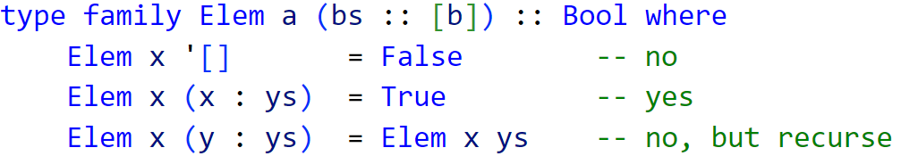
Type-level programming : introduction
Type-indexing
Type families
DataKinds Extension

Slide 20
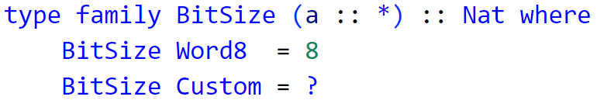
Type-Level : composition
Memory Representation
Composition explicit
Closed system
Primitive Types

Slide 21
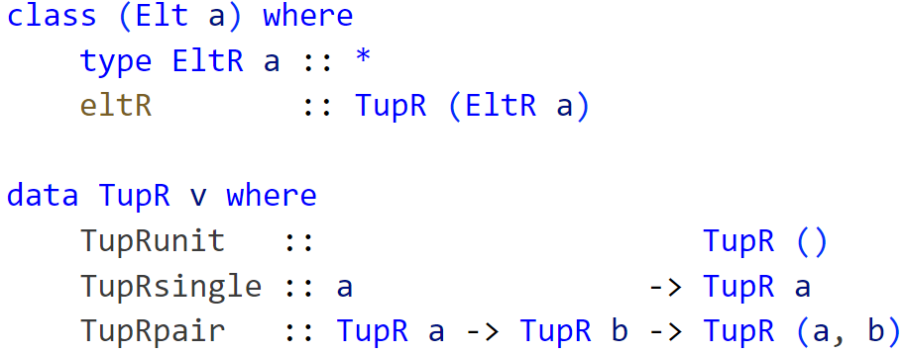
Datatypes in Embedded Languages
Abstract Syntax Tree
Constraint through GADT

Slide 22
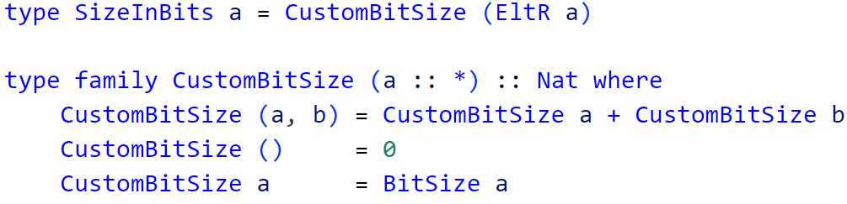
Type-Level : solution

Slide 23
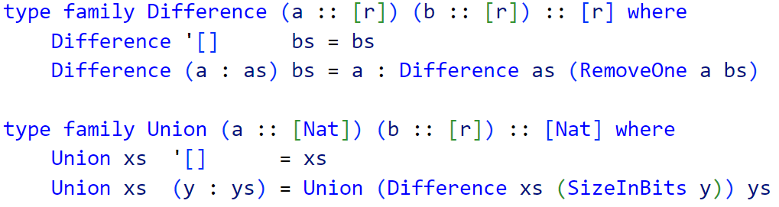
Type-Level : deduplication
Deduplication
Intermediate structure

Slide 24
Type-Level : what now?
Mapping
Type Safety
Extendable
Preserve Information

Slide 25
(De)constructing variant types

Slide 26
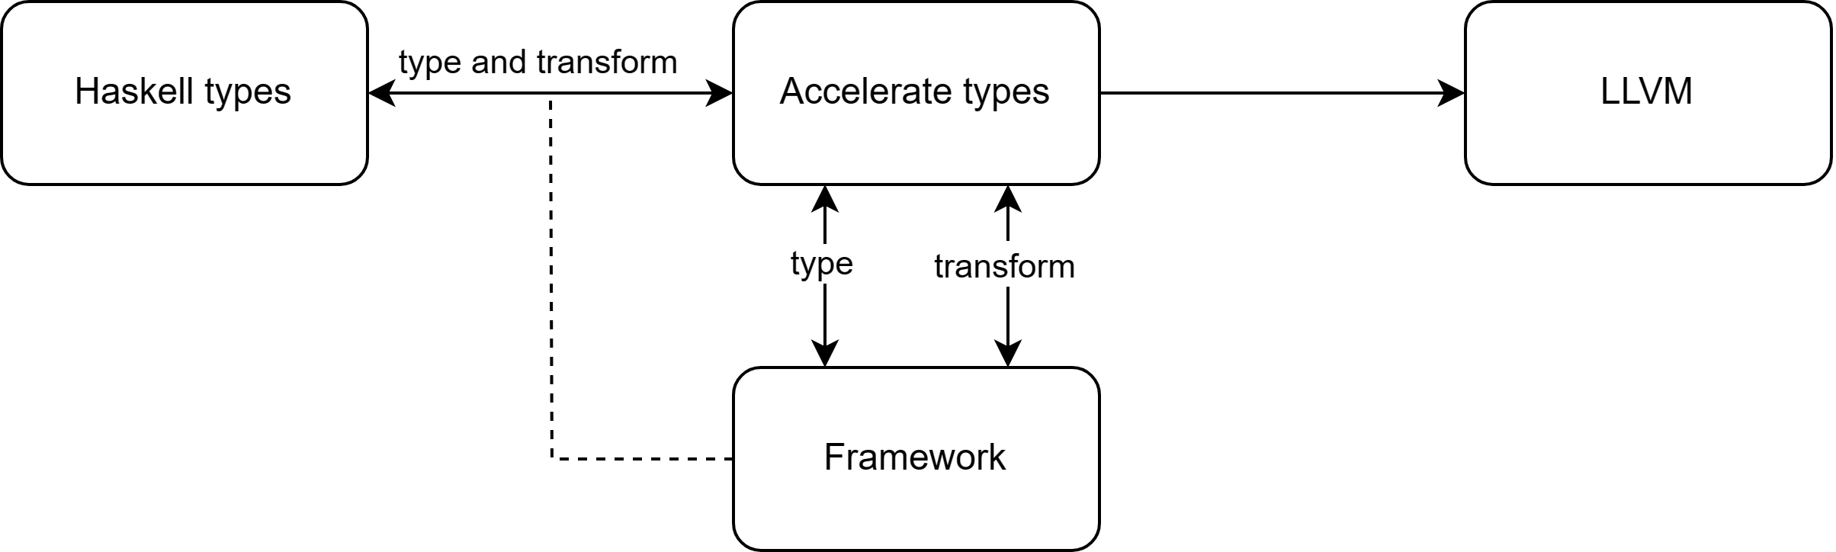
Datatype-Generic : introduction
Extending behavior
Parameterization on the composition
Goal : mapping between datatypes
(De)construction
Bitsize

Slide 27
Datatype-Generic : closed system
GADT
Refine the type

Slide 28
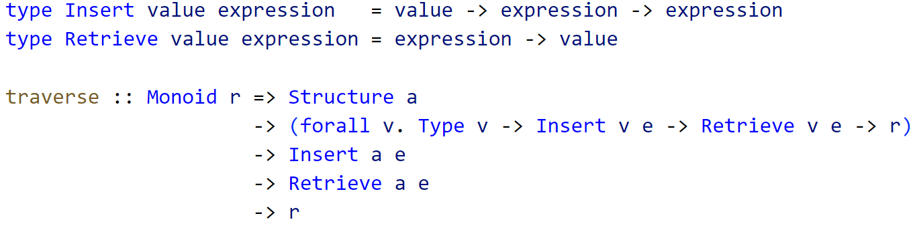
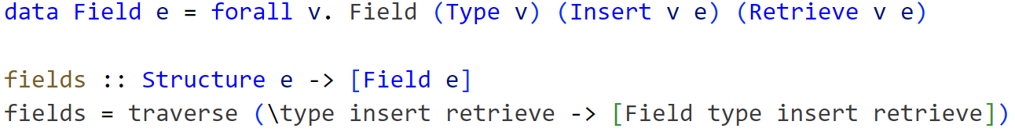
Datatype-Generic : deduplication

Slide 29
Datatype-Generic : considerations
Isomorphic
Compact
Truncation
Type Safety
Type-level sorting

Slide 30
Implementation in Accelerate

Slide 31
Implementation : introduction
Accelerate
Deeply Embedded
Disconnection between Surface and Embedded
Embedded Pattern Matching

Slide 32
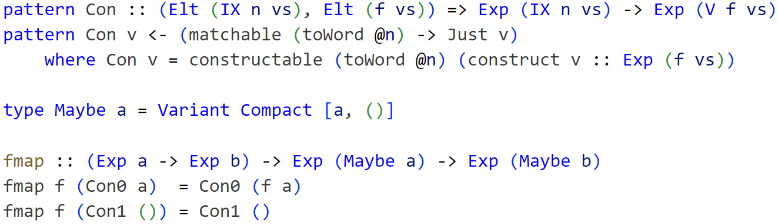
Implementation : pattern synonyms

Slide 33
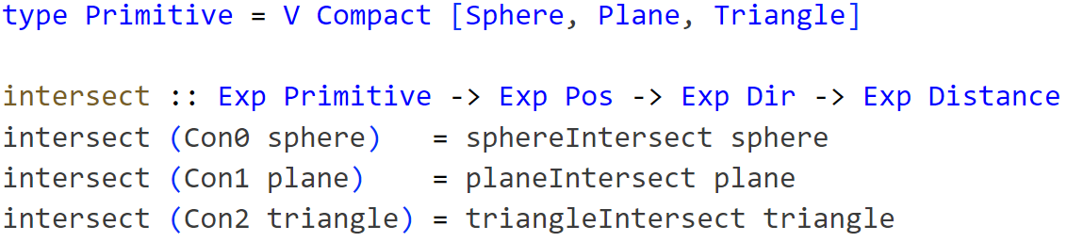
Implementation : result
Memory Representation
(De)constructors
Data structures

Slide 34
What next?

Slide 35
Discussion

Slide 36
Notes:
Any questions?

